Slide 1

FINE TUNING: FALCON-7B LLM (CONCEPTS)
1
PRASUN DUTTA

Slide 2
LARGE LANGUAGE MODELS
2
Large Language Models (LLM) are very large deep learning models that are pre-trained on vast amounts of data. The underlying transformer is a set of neural networks that consist of an encoder and a decoder with self-attention capabilities. The encoder and decoder extract meanings from a sequence of text and understand the relationships between words and phrases in it.
Unlike earlier recurrent neural networks (RNN) that sequentially process inputs, transformers process entire sequences in parallel. This allows the data scientists to use GPUs for training transformer-based LLMs, significantly reducing the training time.
Large language models are incredibly flexible. One model can perform completely different tasks such as answering questions, summarizing documents, translating languages and completing sentences. LLMs have the potential to disrupt content creation and the way people use search engines and virtual assistants.

Slide 3
FALCON-7B
3
Falcon is a new family of state-of-the-art language models created by the Technology Innovation Institute. The Falcon family is composed of two base models: Falcon-40B and Falcon-7B, the 7B parameter model is the best in its weight class [3].
Falcon-7B is a 7B parameters causal decoder-only model and fine-tuned on a mixture of chat/instruct datasets, making them particularly suitable for popular assistant-style tasks [3].
Falcon-7B has been trained on 1.5 trillion tokens, in line with modern models optimizing for inference. The architecture of Falcon was optimized for performance and efficiency [3].
Combining high-quality data with these optimizations, Falcon significantly outperforms GPT-3 for only 75% of the training compute budget—and requires a fifth of the compute at inference time [3].

Slide 4
FALCON-7B
4
Notably, the majority of the training data (>80%) is derived from RefinedWeb - a novel massive web dataset based on CommonCrawl (Common Crawl is a nonprofit 501(c)(3) organization that crawls the web and freely provides its archives and datasets to the public) [3].
Falcon RefinedWeb was created to serve as an English large-scale dataset for the pretraining of large language models. It may be used on its own, or augmented with curated sources (e.g., Wikipedia, StackOverflow) [3].
The Falcon models incorporate an interesting feature called multi-query attention. Unlike the traditional multi-head attention scheme, which has separate query, key, and value embeddings per head, multi-query attention shares a single key and value across all attention heads [5].
This innovation enhances the scalability of inference, significantly reducing memory costs and enabling optimizations like statefulness. The smaller K, V-cache during autoregressive decoding contributes to these benefits [5].

Slide 5
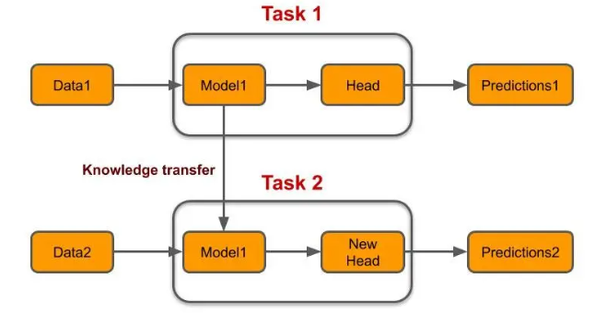
FINE TUNING
5
While a pre-trained LLM possesses general knowledge, it might need help with specific domain questions and abbreviations. This is where fine-tuning comes into play. It’s similar to transferring knowledge. These expansive language models undergo training on extensive datasets using substantial computational resources and boast millions of parameters [4].
Fig 1: Transfer Learning [4]

Slide 6
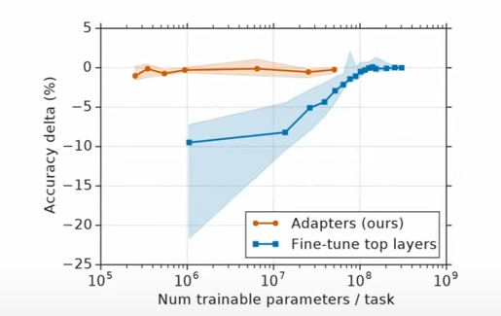
PEFT: PARAMETER EFFICIENT FINE TUNING
6
I. ADAPTER-TUNING
Fine-tuning involves copying the weights form a pre-trained network and tuning them on the downstream task (a new set of weights for each task).
Multi-task learning requires simultaneous access to all tasks (memory intensive).
Adapters yield “parameter-efficient tuning” for NLP. It permits training on tasks sequentially.
Tuning with adapter modules involves adding a small number of new parameters to a model, which are trained on the downstream task.
In adapter-tuning, the parameters of the original network are frozen and therefore may be shared by many tasks.
Fig 2: Trade-off between accuracy and number of trained task-specific parameters. For adapter tuning and fine-tuning [1]

Slide 7
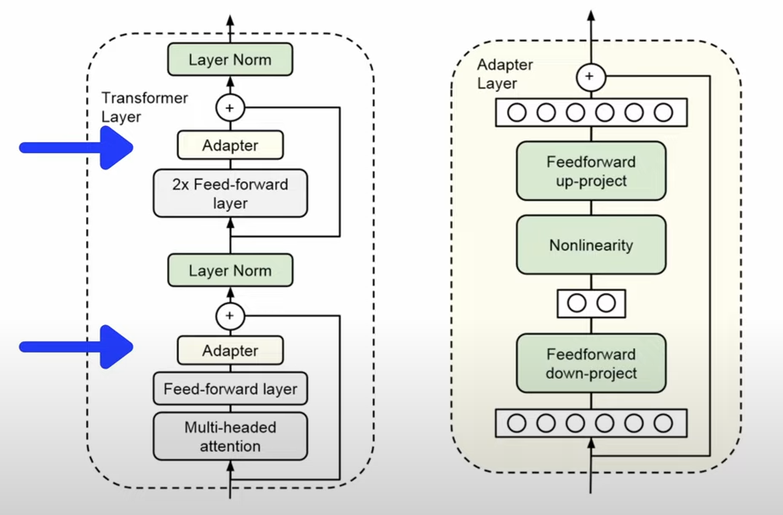
PEFT: PARAMETER EFFICIENT FINE TUNING
7
I. ADAPTER-TUNING
Adapter tuning involves: injecting new layers into the transformer.
Adapters are trained in the same manner as full fine-tuning of the model. The information is passed through the different layers of the transformer where additionally to the pre-trained weights at every layer, the representations are additionally passed through the adapter parameters [1].
However, in contrast to full fine-tuning, the pre-trained weights θ are fixed and only the adapter weights φ and the prediction head are trained. Because θ is fixed, the adapter weights φ are encapsulated within the transformer weights, forcing them to learn compatible representation across tasks [1].
Fig 3: Architecture of adapter module and its integration with the transformer [1]

Slide 8
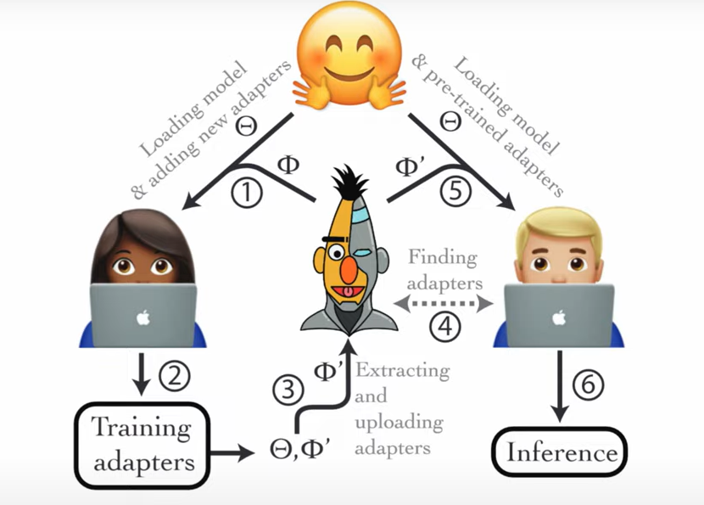
PEFT: PARAMETER EFFICIENT FINE TUNING
8
I. ADAPTER-TUNING
Adapters φ are introduced into a pre-trained transformer θ
They are trained
They can be extracted and open-sourced
They are visualizable
Pre-trained adapters are downloaded on-the-fly
Then can be stitched into a model that is used for inference.
Fig 4: AdapterHub Process Graph [2]
Adapter Hub: A framework for Adapting transformers

Slide 9
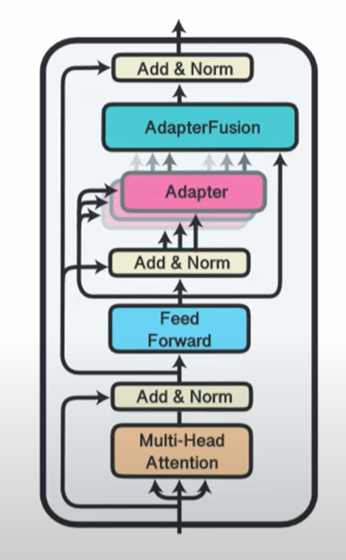
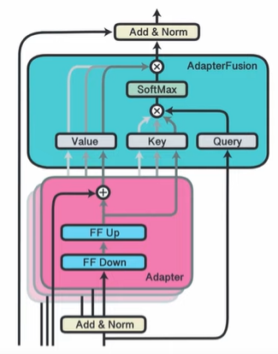
PEFT: PARAMETER EFFICIENT FINE TUNING
9
I. ADAPTER-TUNING
Sequential fine-tuning and multi-task learning are methods aiming to incorporate knowledge from multiple task; however, they suffer from catastrophic forgetting and difficulties in dataset balancing.
To address these shortcomings, AdapterFusion, a new two stage learning algorithm that leverages knowledge from multiple tasks was introduced [6]:
In the knowledge extraction stage we learn task specific parameters called adapters, that encapsulate the task-specific information.
We then combine the adapters in a separate knowledge composition step.
Fig 5: AdapterFusion Architecture [6]

Slide 10
PEFT: PARAMETER EFFICIENT FINE TUNING
10
II. LoRA: Low Rank Adaptation
LoRA (Low-Rank Adaptation of Large Language Models): Freezes the pre-trained model weights and injects trainable rank decomposition matrices into each layer of the transformer architecture.
During full fine-tuning, the model is initialized to pre-trained weights φ and all are updated to φ + Δφ by repeatedly following the gradient.
One of the main drawbacks for full fine-tuning is that for each downstream task, we learn a different set of parameters Δφ
LoRA adopts a more parameter-efficient approach, where the task-specific parameter increment Δφ = Δφ(θ) is further encoded by a much smaller-sized set of parameters θ [7].
LoRA proposes to use a Low-Rank representation to encode Δφ

Slide 11
PEFT: PARAMETER EFFICIENT FINE TUNING
11
II. LoRA: Low Rank Adaptation
WHY WOULD WE DO THIS ??
When we train fully connected (i.e., “dense”) layers in a neural network, the weight matrices usually have full rank, meaning that a matrix does not have any linearly dependent (i.e., “redundant”) rows or columns. In contrast, to full rank, low rank means that the matrix has redundant rows or columns.
So, while the weights of a pre-trained model have full rank on the pre-trained tasks, the LoRA authors point out that pre-trained large language models have a low “intrinsic dimension” when they are adapted to a new task, according to [9].
A low intrinsic dimension means the data can be effectively represented or approximated by a lower-dimensional space while retaining most of its essential information or structure. In other words, this means we can decompose the new weight matrix for the adapted task into lower-dimensional (smaller) matrices without losing too much important information.

Slide 12
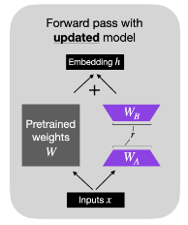
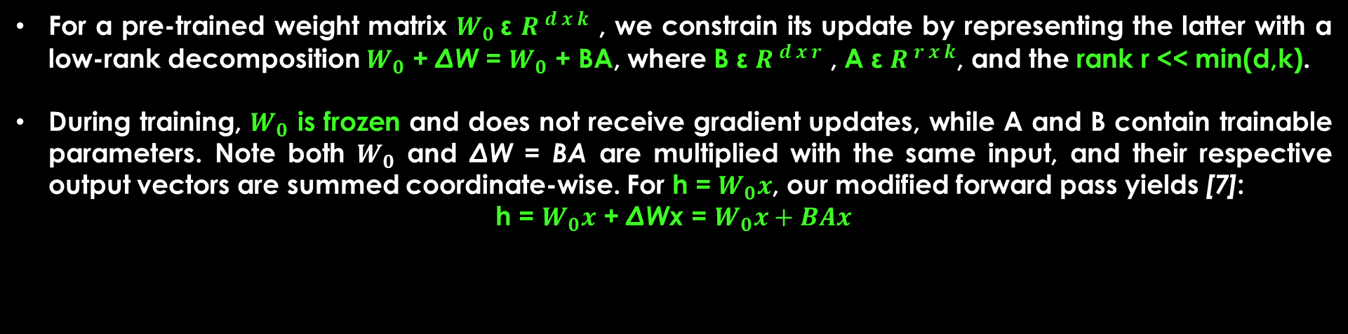
PEFT: PARAMETER EFFICIENT FINE TUNING
12
II. LoRA: Low Rank Adaptation
For a pre-trained weight matrix $W_{0}$ε ${R }^{d x k}$ , we constrain its update by representing the latter with a low-rank decomposition $W_{0}$ + ΔW = $W_{0}$ + BA, where B ε ${R }^{d x r}$ , A ε ${R }^{r x k}$, and the rank r << min(d,k).
During training, $W_{0}$ is frozen and does not receive gradient updates, while A and B contain trainable parameters. Note both $W_{0}$ and ΔW = BA are multiplied with the same input, and their respective output vectors are summed coordinate-wise. For h = $W_{0}x$, our modified forward pass yields [7]:
h = $W_{0}x$ + ΔWx = $W_{0}x+BAx$
Fig 6: LoRA weights, $W_{A}$ and $W_{B}$, represent ΔW [10]

Slide 13
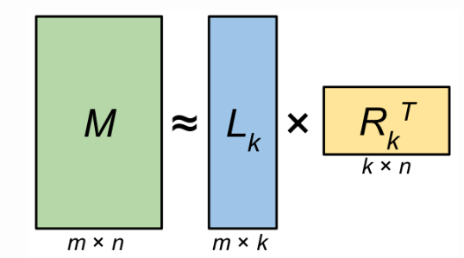
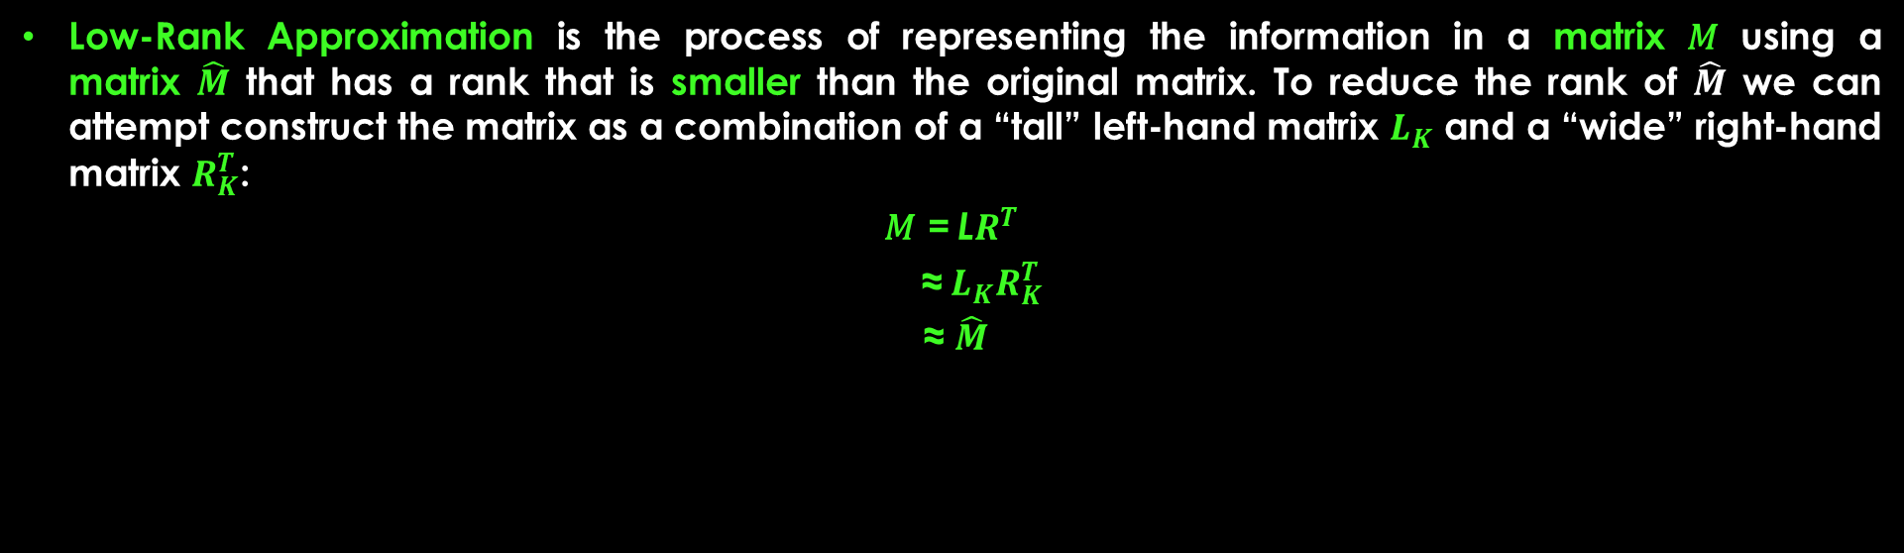
PEFT: PARAMETER EFFICIENT FINE TUNING
13
II. LoRA: Low Rank Adaptation
LOW RANK APPROXIMATION: SVD
Low-Rank Approximation is the process of representing the information in a matrix 𝑀 using a matrix $\hat{M}$ that has a rank that is smaller than the original matrix. To reduce the rank of $\hat{M}$ we can attempt construct the matrix as a combination of a “tall” left-hand matrix $L_{K}$ and a “wide” right-hand matrix $R_{K}^{T}$:
𝑀 = L$R^{T}$
≈${ L}_{K}R_{K}^{T}$
≈ $\hat{M}$
Fig 7: Low-rank Matrix Decomposition: A matrix 𝑀 of size m x n and rank r can be decomposed into a pair of matrices $L_{K}$ and $R_{K}$. When k = r, the matrix M can be exactly reconstructed from the decomposition. When k < r, then the decomposition provides a low-rank approximation $\hat{M}$ of 𝑀 [8]

Slide 14

PEFT: PARAMETER EFFICIENT FINE TUNING
14
II. LoRA: Low Rank Adaptation
LOW RANK APPROXIMATION: SVD
There are a number of methods for constructing the matrix $\hat{M}$, but a common method is to use Singular Value Decomposition (SVD). Specifically, SVD decomposes matrix M into three matrices:
M = US$V^{T}$
= (US)$V^{T}$
= L$R^{T}$, where
L = (US), and R=V
Note that, we’re not limited to exact reconstruction of 𝑀; SVD offers a straight-forward way to obtain a low-rank approximation of 𝑀. We can replace 𝑈, 𝑆, and 𝑉 in above equation with $U_{K}$, $S_{K}$, and $V_{K}$, where we use only the first 𝑘 columns of the decomposition matrices:
𝑀 ≈ $U_{K}S_{K}V_{K}^{T}$
≈ $\hat{M}$
When k < r then above Equation provides a LRA of 𝑀, $\hat{M}$ via SVD [8].

Slide 15
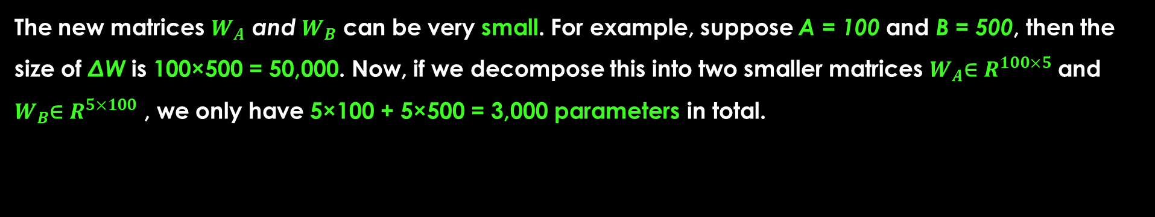
PEFT: PARAMETER EFFICIENT FINE TUNING
15
II. LoRA: Low Rank Adaptation
HOW IS THIS PARAMETER EFFICIENT IF WE INTRODUCE NEW WEIGHT MATRICES ?
The new matrices $W_{A}$ and $W_{B}$ can be very small. For example, suppose A = 100 and B = 500, then the size of ΔW is 100×500 = 50,000. Now, if we decompose this into two smaller matrices $W_{A}$∈ $R^{100×5 }$and $W_{B}$∈ $R^{5×100}$ , we only have 5×100 + 5×500 = 3,000 parameters in total.

Slide 16
PEFT: PARAMETER EFFICIENT FINE TUNING
16
III. QLoRA: Quantization & Low Rank Adapters
4-bit Quantization of weights and Parameter Efficient Fine Tuning (PEFT), we choose the PEFT method: LoRA and train injected adapter weights (LoRA) in 32-bit precision.
QLoRA has one storage data type (usually 4-bit NormalFloat) and a computation data type (16-bit BrainFloat)
We dequantize the storage data type to the computation data type to perform the forward and backward pass, but we only compute weight gradients for the LoRA parameters which use 16-bit BrainFloat.

Slide 17
PEFT: PARAMETER EFFICIENT FINE TUNING
17
III. QLoRA: Quantization & Low Rank Adapters
4-bit NormalFloat (NF4) Quantization
Normalization: The weights of the model are first normalized to have zero mean and unit variance. This ensures that the weights are distributed around zero and fall within a certain range.
Quantization: The normalized weights are then quantized to 4-bits. This involves mapping the original high-precision weights to a smaller set of low-precision values. In the case of NF4, the quantization levels are chosen to be evenly spaced in the range of the normalized weights.
Dequantization: During the forward pass and backpropagation, the quantized weights are dequantized back to full precision. This is done by mapping the 4-bit quantized values back to their original range. The dequantized weights are used in the computations, but they are stored in memory in their 4-bit quantized form.

Slide 18
PEFT: PARAMETER EFFICIENT FINE TUNING
18
III. QLoRA: Quantization & Low Rank Adapters
4-bit NormalFloat (NF4) Quantization
EXAMPLE
Let us suppose a weight in our NN is a 32-bit floating point number, and its value is 0.5678.
Let’s say our 4-bit integers represent 16 levels evenly spaced between -1 and 1. These levels would be: -1.0, -0.8667, -0.7333, -0.6, -0.4667, -0.3333, -0.2, -0.0667, 0.0667, 0.2, 0.3333, 0.4667, 0.6, 0.7333, 0.8667, 1.0
Our original weight value of 0.5678 is closest to 0.6, so we would quantize this weight to 0.6.
In our 4-bit representation, let’s say 0.6 corresponds to the integer 13. We store the 4-bit integer 13 instead of the 32-bit floating-point number 0.5678.
If we use this weight in a computation, we first dequantize it back (0.6) to the floating-point number. The dequantization error is 0.6 – 0.5678 = 0.0322 (rem: 1 level spaced out is 0.1333 → ¼ of a space)

Slide 19
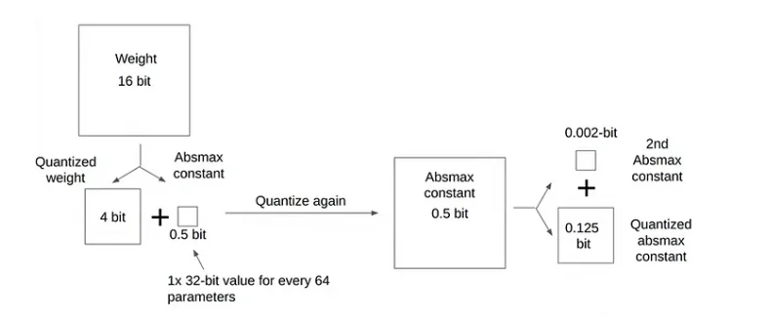
PEFT: PARAMETER EFFICIENT FINE TUNING
19
III. QLoRA: Quantization & Low Rank Adapters
Double Quantization
Double quantization is the process of quantizing the quantization constant to reduce the memory down further to save these constant.
If we employed blockwise quantization, then we will have n quantization constants in their original datatype. In the case of expansive LLM’s which have substantial number of quantization constants that must be stored, leading to increased memory overhead.
Fig 8: Double Quantization [11]

Slide 20
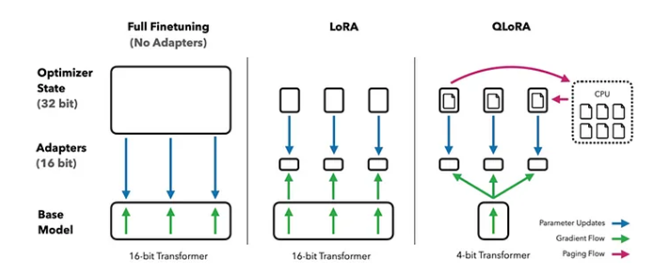
PEFT: PARAMETER EFFICIENT FINE TUNING
19
III. QLoRA: Quantization & Low Rank Adapters
In this method, the original pre-trained weights of the model are quantized to 4-bit and kept fixed during fine-tuning. Then, a small number of trainable parameters in the form of low-rank adapters are introduced during fine-tuning. These adapters are trained to adapt the pre-trained model to the specific task it is being fine-tuned for, in 32-bit floating-point format [11].
When it comes to computations (like forward and backward passes during training, or inference), the 4-bit quantized weights are dequantized back to 32-bit floating-point numbers.
After the fine-tuning process, the model consists of the original weights in 4-bit form, and the additional low-rank adapters in their higher precision format.
Fig 9: Different finetuning methods and their memory requirements. QLoRA improves over LoRA by quantizing the transformer model to 4-bit precision and using paged optimizers to handle memory spikes [11]

Slide 21
PEFT: PARAMETER EFFICIENT FINE TUNING
20
III. QLoRA: Quantization & Low Rank Adapters
The additional low-rank adapters in the QloRA method are in a higher precision format, typically 32-bit floating-point (bfloat16), for a few reasons [11]:
Higher precision allows the model to capture more subtle patterns in the data. This is particularly important for the low-rank adapters, as they are responsible for adapting the pre-trained model to the specific task it is being fine-tuned for.
Training neural networks involves a lot of incremental updates to the weights. Weights in higher precision format ensures updates are accurately captured.
While quantizing all weights can save memory, the computational efficiency might not always improve. GPUs are optimized for 32-bit (bfloat16) operations. Computations with 32-bit floating-point can be faster than with lower precision.
QLoRA backpropapgates gradients through a frozen, 4-bit quantized pre-trained language model into Low Rank Adapters (LoRA) [11]

Slide 22
PEFT: PARAMETER EFFICIENT FINE TUNING
21
BENEFITS OF PEFT
Decreased computational and storage costs: PEFT involves fine-tuning only a small number of extra model parameters while freezing most parameters of the pre-trained LLMs, thereby reducing computational and storage costs significantly.
Overcoming catastrophic forgetting: During full fine-tuning of LLMs, catastrophic forgetting can occur where the model forgets the knowledge it learned during pre-training. PEFT stands to overcome this issue by only updating a few parameters.
Better performance in low-data regimes: PEFT approaches have been shown to perform better than full fine-tuning in low-data regimes and generalize better to out-of-domain scenarios.
Portability: PEFT methods enable users to obtain tiny checkpoints worth a few MBs compared to the large checkpoints of full fine-tuning. This makes the trained weights from PEFT approaches easy to deploy and use for multiple tasks without replacing the entire model.
Performance comparable to full fine-tuning: PEFT enables achieving comparable performance to full fine-tuning with only small number of trainable parameters.

Slide 23
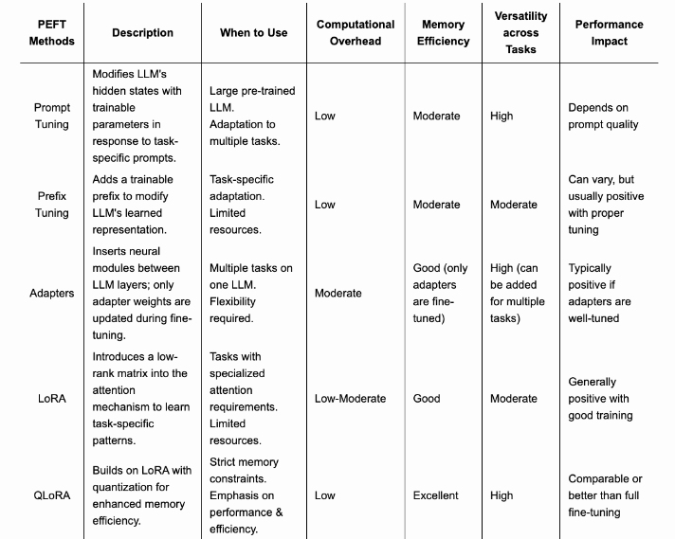
PEFT: PARAMETER EFFICIENT FINE TUNING
22
KEY TAKEAWAYS
Fig 9: Comparative Analysis of PEFT Methods [12]

Slide 24
REFERENCES
23
[1] Houlsby, N., Giurgiu, A., Jastrzebski, S., Morrone, B., Quentin, D. L., Gesmundo, A., Attariyan, M., & Gelly, S. (2019). Parameter-Efficient Transfer Learning for NLP. arXiv.org. https://arxiv.org/abs/1902.00751
[2] Pfeiffer, Jonas & Rücklé, Andreas & Poth, Clifton & Kamath, Aishwarya & Vulić, Ivan & Ruder, Sebastian & Cho, Kyunghyun & Gurevych, Iryna. (2020). AdapterHub: A Framework for Adapting Transformers. 46-54. 10.18653/v1/2020.emnlp-demos.7.
[3] Almazrouei, E., Alobeidli, H., Alshamsi, A., Cappelli, A., Cojocaru, R., Debbah, M., Goffinet, É., Hesslow, D., Launay, J., Malartic, Q., Mazzotta, D., Noune, B., Pannier, B., & Penedo, G. (2023). The Falcon series of open language models. arXiv.org. https://arxiv.org/abs/2311.16867
[4] Mehra, A. (2024). Fine-Tuning tutorial: Falcon-7B LLM to a General purpose chatbot. Labellerr. https://www.labellerr.com/blog/hands-on-with-fine-tuning-llm/
[5] Shazeer, N. (2019). Fast Transformer Decoding: One Write-Head is All You Need. arXiv.org. https://arxiv.org/abs/1911.02150
[6] Pfeiffer, J., Kamath, A., Rücklé, A., Cho, K., & Gurevych, I. (2020). AdapterFusion: Non-Destructive task composition for transfer learning. arXiv.org. https://arxiv.org/abs/2005.00247
[7] Hu, E. J., Shen, Y., Wallis, P., Allen-Zhu, Z., Li, Y., Wang, S., Wang, L., & Chen, W. (2021). LORA: Low-Rank adaptation of Large Language Models. arXiv.org. https://arxiv.org/abs/2106.09685
[8] Stansbury, D. (2020). SVD and Data Compression Using Low-rank Matrix Approximation. The Clever Machine. https://dustinstansbury.github.io/theclevermachine/svd-data-compression
[9] Aghajanyan, A., Zettlemoyer, L., & Gupta, S. (2020). Intrinsic dimensionality explains the effectiveness of language model Fine-Tuning. arXiv.org. https://arxiv.org/abs/2012.13255
[10] Raschka, S. (2023). Parameter-Efficient LLM Finetuning with Low-Rank Adaptation (LORA). Sebastian Raschka, PhD. https://sebastianraschka.com/blog/2023/llm-finetuning-lora.html
[11] Dettmers, T., Pagnoni, A., Holtzman, A., & Zettlemoyer, L. (2023). QLORA: Efficient Finetuning of Quantized LLMS. arXiv.org. https://arxiv.org/abs/2305.14314
[12] Balne, C. C. S., Bhaduri, S., Roy, T., Jain, V., & Chadha, A. (2024). Parameter Efficient fine tuning: a comprehensive analysis across applications. arXiv.org. https://arxiv.org/abs/2404.13506

Slide 25
24
THANK YOU

